Slide 1
performance analysis of Machine Learning based e-mail spam filters
AI Bootcamp: Assignment 1
By Chantal Andrade

Slide 2
Assignment Details
Examine the given reference, it uses the support vector machine (SVM) algorithm to identify spam emails.
Understand the concepts therein and the workflow.
Practice the code and run on your own machines/Kaggle.
Use two other machine learning algorithms (any two) to detect spam emails.
Measure the accuracy (classification error rate) for each algorithm.

Slide 3
About the task
The assignment was given as a part of the AI Skills Bootcamp in the third week of learning. We were asked to use the reference to see how a spam filter worked using a Support Vector Machine model. We would then have to use the same sample dataset and use two other machine learning models that we’ve learned in the course to create a spam filter, and then compare the accuracy of all the three models to find which one had the highest accuracy that worked for us.
This assignment was done in Visual Studio Code.

Slide 4
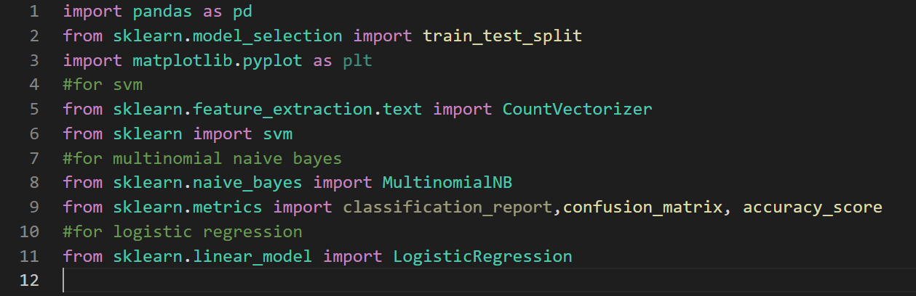
PACKAGES USED

Slide 5
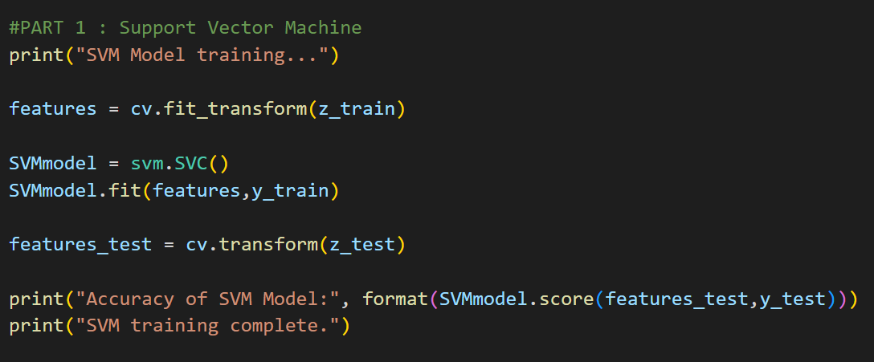
SUPPORT VECTOR MACHINE MODEL

Slide 6
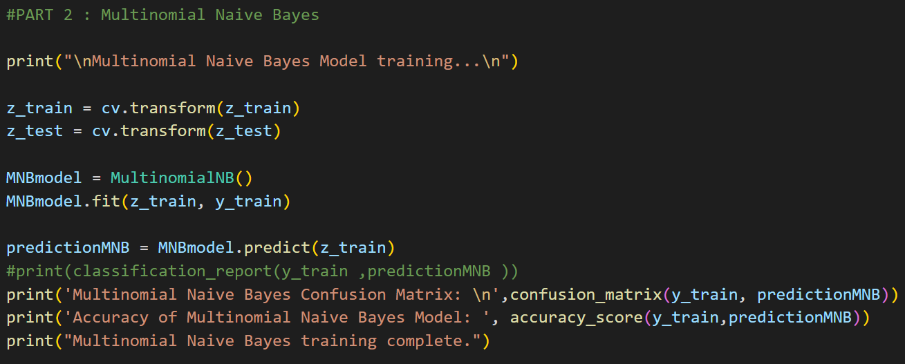
MULTINOMIAL NAÏVE BAYES MODEL

Slide 7
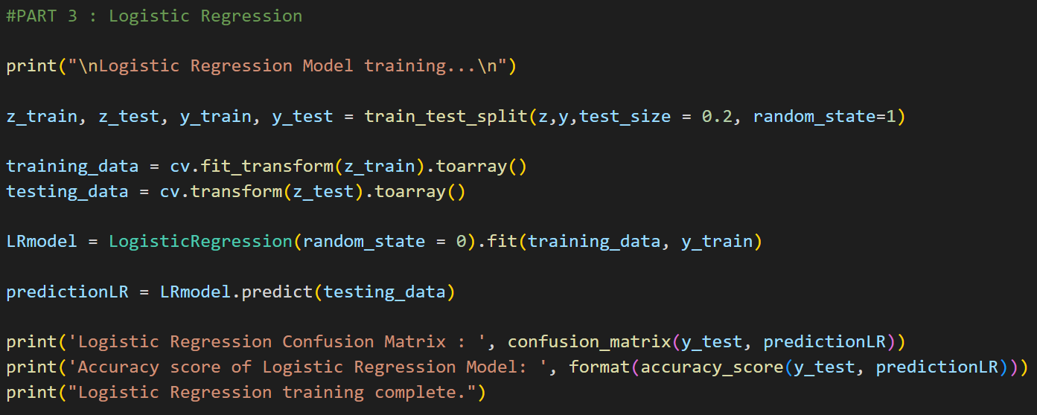
LOGISTIC REGRESSION MODEL

Slide 8
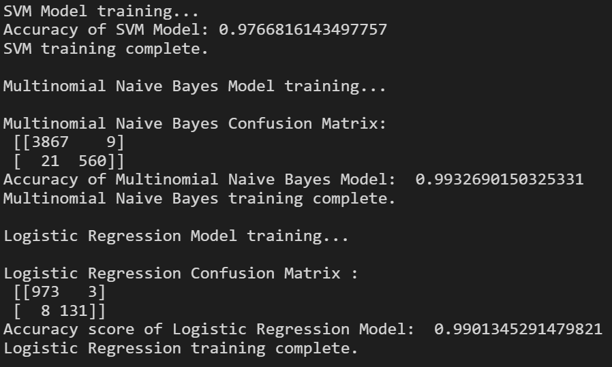
RESULTS

Slide 9
CONCLUSION
The Multinomial Naïve-Bayes model had a higher accuracy than the other two models used, with a score of 0.9932…
The SVM model had the lowest accuracy comparatively, with a score of 0.9766…
Despite these differences, all of the models had a consistently high accuracy and are suitable as email spam filtering algorithms

Slide 10
REFERENCES
https://blog.logrocket.com/email-spam-detector-python-machine-learning/?fbclid=IwAR3p4ajXRJLG_nGaofW2Mgk7Xc896X1mCbaxOT7kjEJnQeYE1ydXiQXAjKM
https://randerson112358.medium.com/email-spam-detection-using-python-machine-learning-abe38c889855
https://www.kaggle.com/code/iwasdata/spam-classification-using-multinomial-naive-bayes
https://www.kaggle.com/code/adi0509/spam-detection-logistic-regression

